Slide 1

Lecture 18
Classic Problems

Slide 2
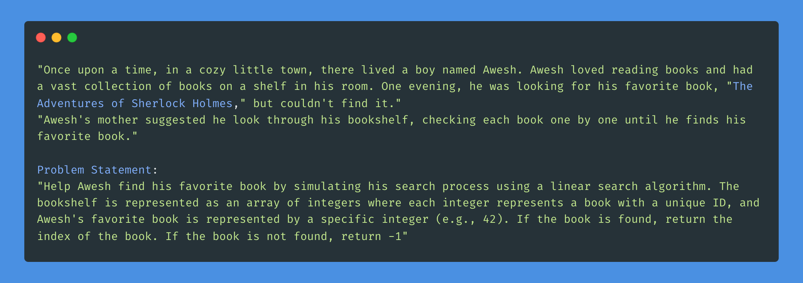
Problem-The Missing Book

Slide 3
Linear Search

Slide 4
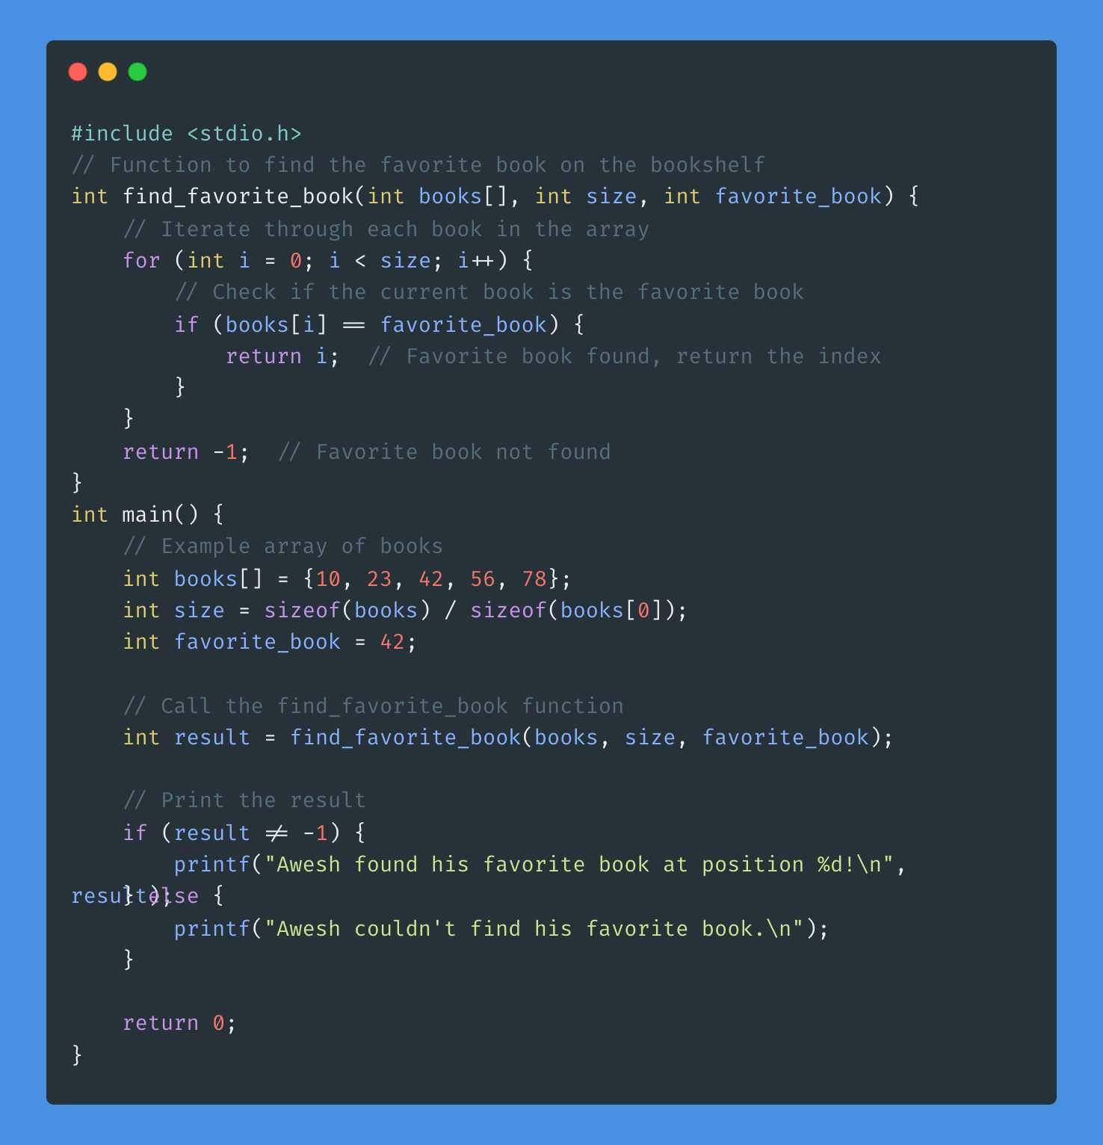
Solve

Slide 5
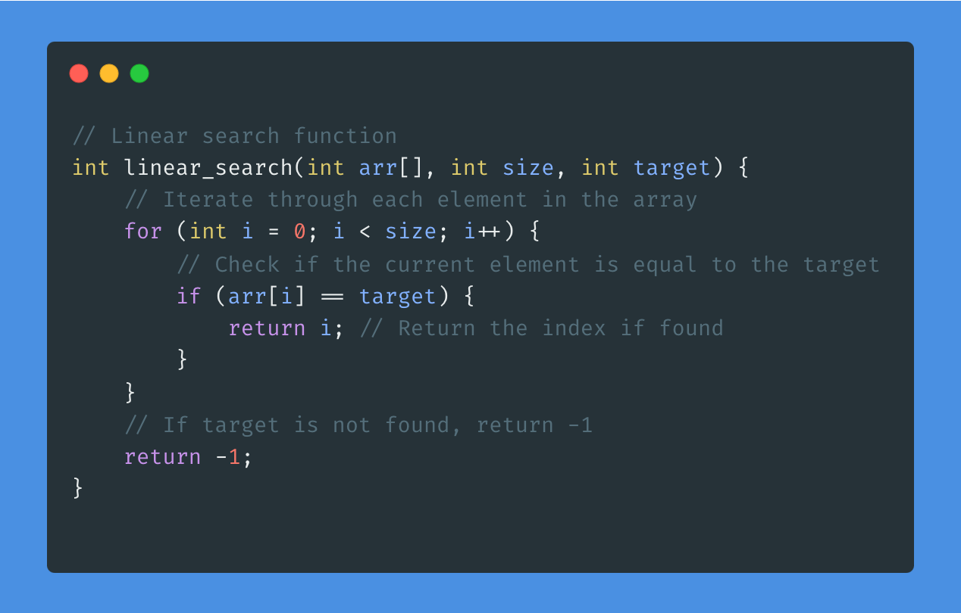
Linear Search Code

Slide 6
Pros of this algorithm
Simplicity: Linear search is straightforward and easy to understand. It involves sequentially checking each element in the array until the target value is found or the end of the array is reached.
Universal Applicability: Linear search can be applied to any type of array, whether it's sorted or unsorted. This makes it versatile and suitable for a wide range of scenarios.
Ease of Implementation: Linear search doesn't require any pre-processing or special data structures. It can be implemented using basic programming constructs like loops and conditional statements, making it accessible to beginners.
Intuitive: The concept of linear search mimics how we might search for an item in a list manually, making it intuitive for beginners to grasp.

Slide 7
Problems of this algorithm
Inefficiency for Large Datasets: Linear search can be inefficient for large datasets because it checks each element one by one until it finds the target value or reaches the end of the array. This can result in longer search times, especially for arrays with many elements.
Performance Degradation: As the size of the array increases, the time taken to perform linear search also increases linearly. This can lead to performance degradation, particularly for applications that require quick search times.
Not Suitable for Sorted Arrays: While linear search works for both sorted and unsorted arrays, it is particularly ineffective for searching in sorted arrays. Other search algorithms like binary search offer better performance for sorted arrays.
Limited Scalability: Linear search may not scale well for applications with large or rapidly growing datasets. In such cases, more efficient search algorithms may be required to maintain acceptable performance levels.

Slide 8
Binary Search
LET’S PLAY A GAME!

Slide 9
Binary Search

Slide 10
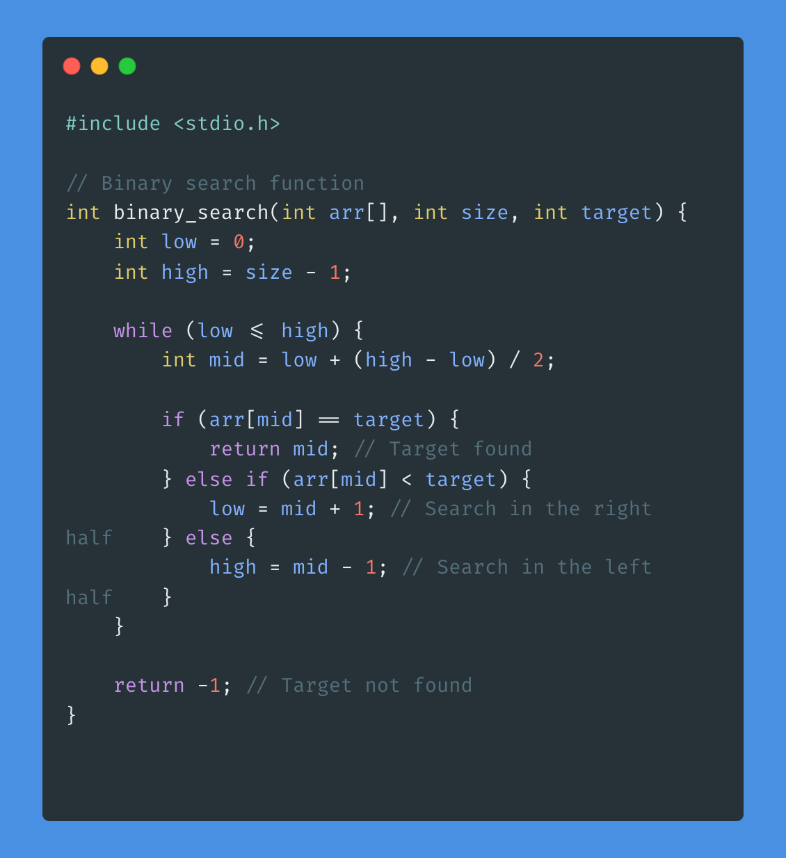
Binary Search

Slide 11
Pros of this algorithm
Efficiency: Binary search has a time complexity of O(log n), making it highly efficient for searching in sorted arrays or lists.
Optimal Performance: It achieves the best possible time complexity for searching in sorted arrays without additional information.
Simple Implementation: Binary search follows a straightforward approach, making it easy to understand and implement.
Space Efficiency: It operates on the original array without requiring additional space for auxiliary data structures, ensuring memory efficiency.
Versatility: Binary search can be applied to various data structures, including arrays, lists, and trees, as long as the elements are sorted, enhancing its usefulness in a wide range of applications.

Slide 12
Problems of this algorithm
Requirement of Sorted Data: Binary search requires the array to be sorted in ascending or descending order. If the array is unsorted or if sorting is not feasible, binary search cannot be directly applied, and preprocessing steps are required.
Limited Applicability: Binary search is not suitable for all types of data structures. It works best for arrays and lists where elements are accessible via indices. It may not be suitable for complex data structures like trees or graphs.
Memory Overhead: Binary search typically requires more memory overhead than linear search, as it involves additional variables to keep track of the search space and indices. However, the memory overhead is generally minimal and not a significant concern in most cases.
Lack of Flexibility: While binary search is highly efficient for searching in sorted arrays, it may not be the best choice for dynamic or frequently changing datasets. Maintaining the sorted order of the array can be challenging in such scenarios.

Slide 13
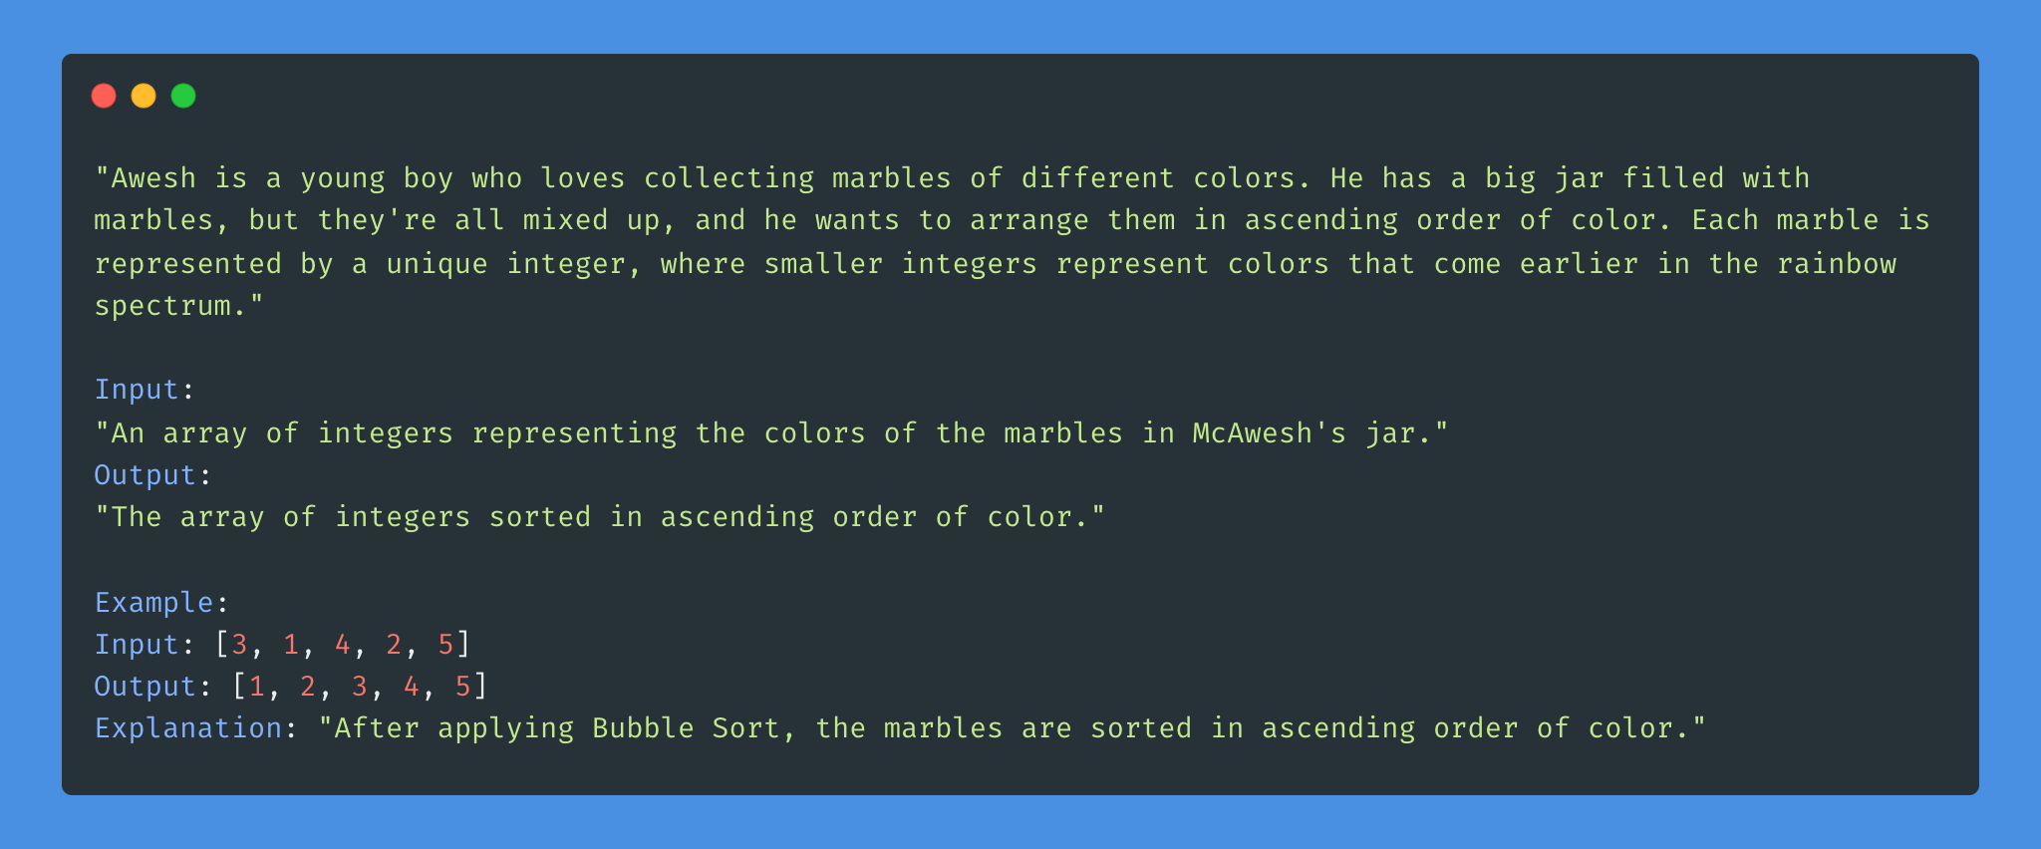
Problem: Sorting Marbles

Slide 14
Bubble Sort

Slide 15
Pros and Cons
Pros:
Simple Implementation: Bubble Sort is one of the simplest sorting algorithms to implement, making it easy to understand for beginners.
No Extra Space: Bubble Sort sorts the elements in place without requiring any additional space, which can be advantageous for memory-constrained environments.
Stable Sorting: Bubble Sort is stable, meaning that equal elements maintain their relative order after sorting.
Cons:
Inefficiency: Bubble Sort is generally inefficient for large lists or arrays. Its time complexity is O(n^2), which means it becomes slow as the number of elements increases.
Poor Performance: It has poor performance even for small lists compared to more efficient sorting algorithms like Merge Sort and Quick Sort.
Not Adaptive: Bubble Sort doesn't adapt to the input data; it always performs the same number of comparisons and swaps regardless of the initial order of elements.

Slide 16
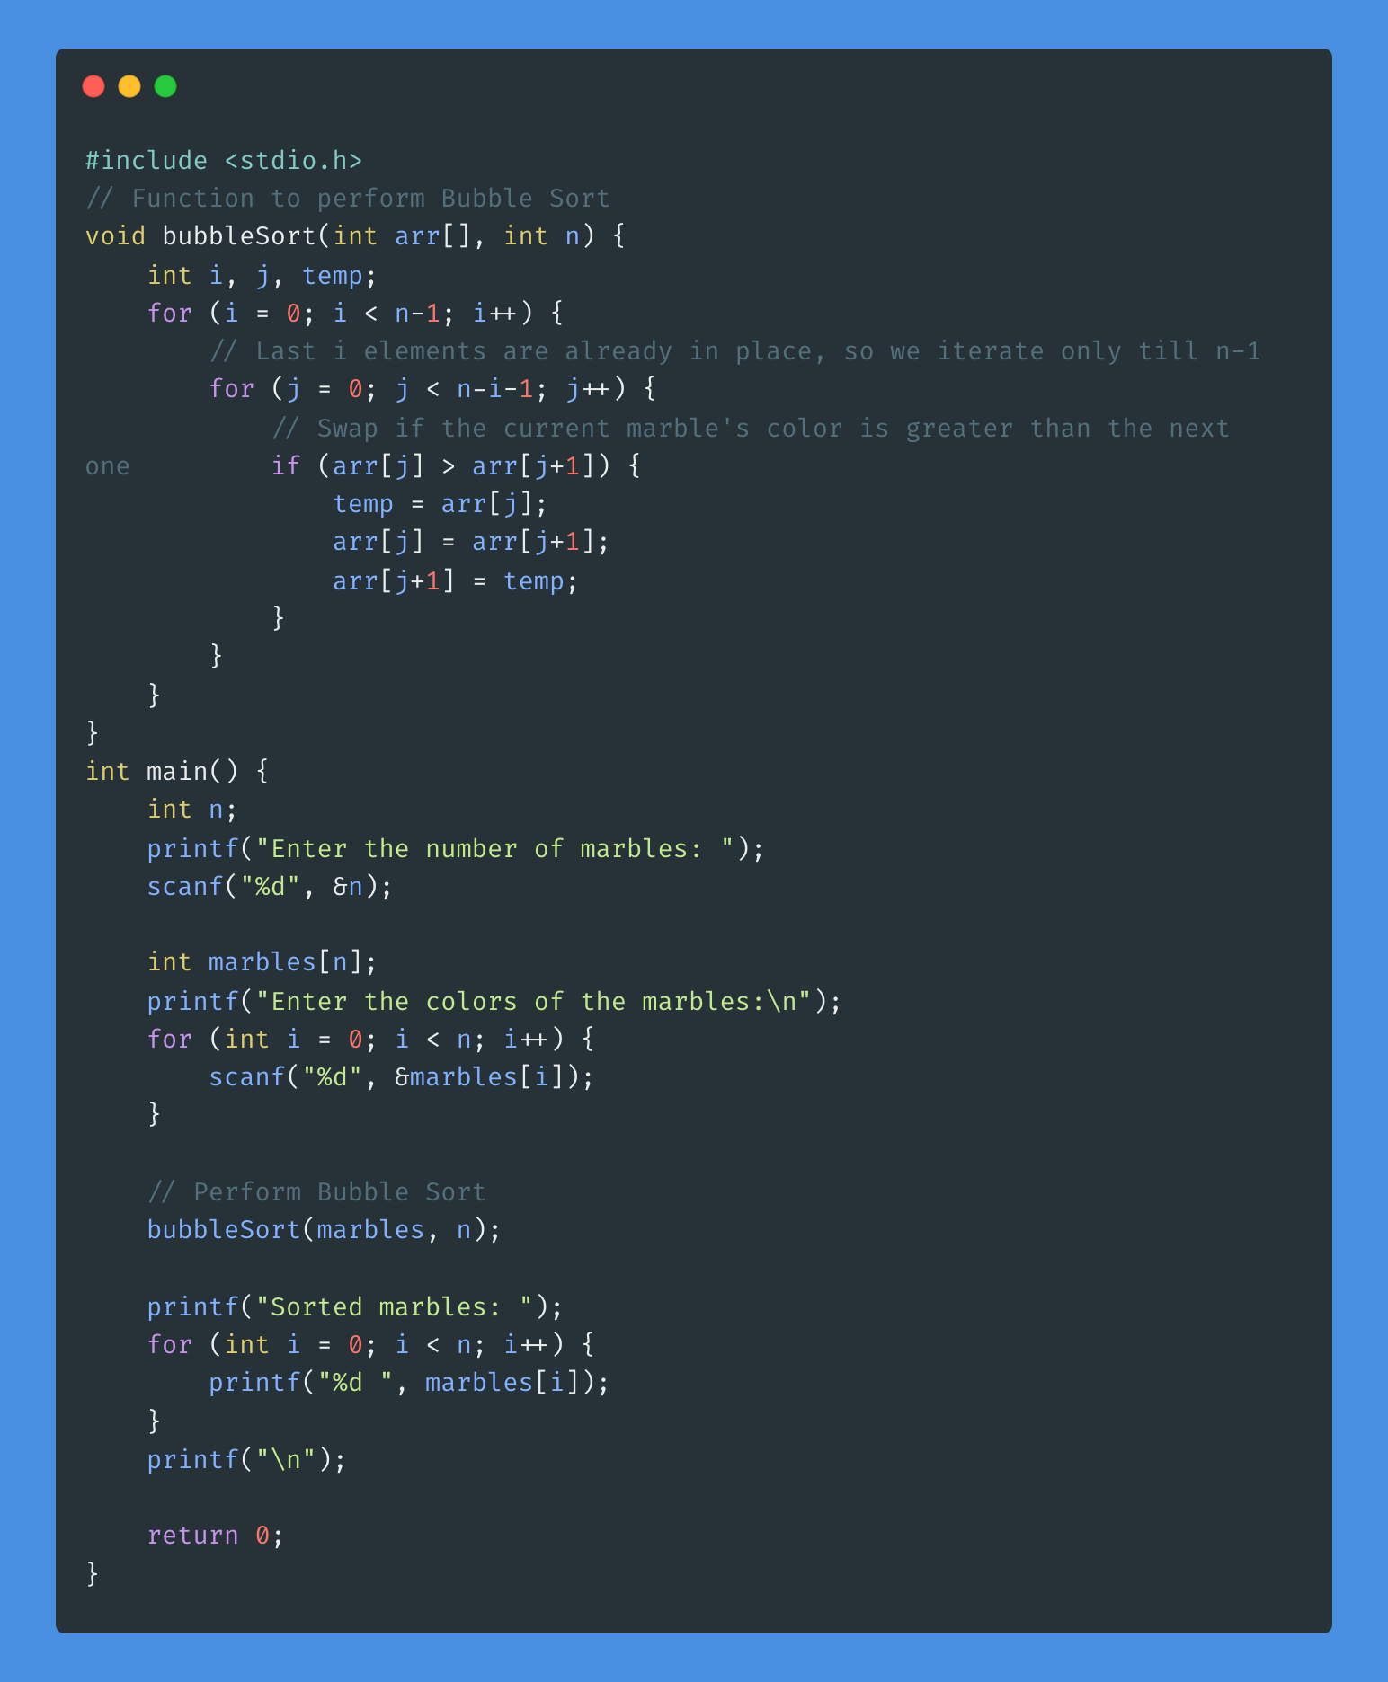
Solve

Slide 17
Selection Sort

Slide 18
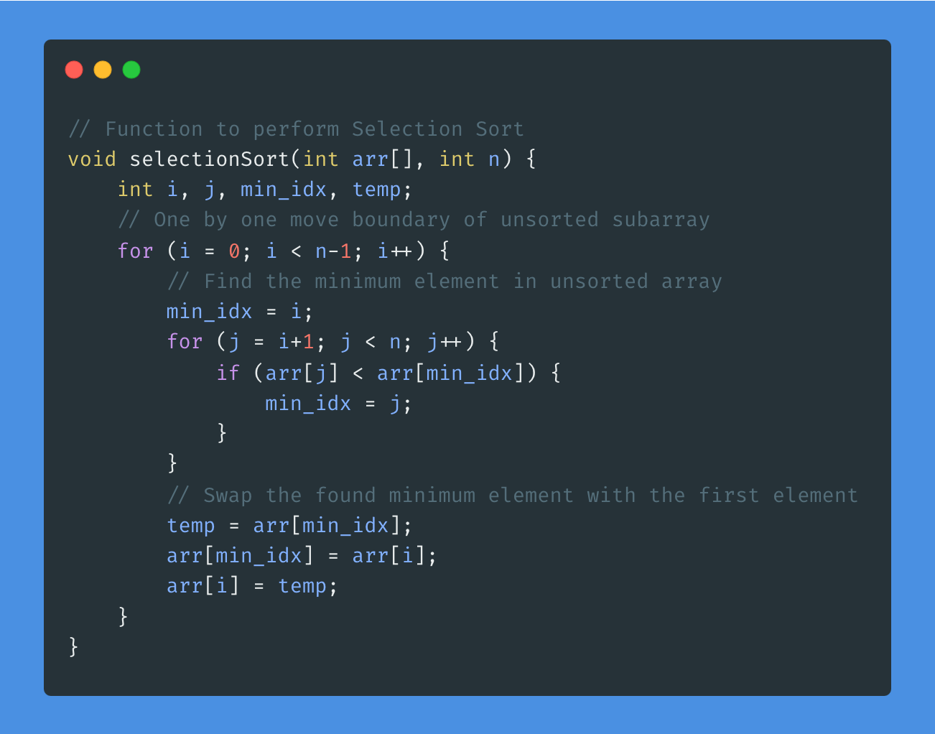
Solve

Slide 19
Pros and Cons
Pros:
Simple Implementation: Selection Sort is also relatively simple to implement, making it suitable for educational purposes or situations where simplicity is preferred over performance.
In-Place Sorting: Similar to Bubble Sort, Selection Sort sorts the elements in place without requiring additional space for temporary storage.
Good for Small Lists: Selection Sort performs reasonably well for small lists or arrays, especially when compared to inefficient algorithms like Bubble Sort.
Cons:
Inefficiency: Like Bubble Sort, Selection Sort has a time complexity of O(n^2), which makes it inefficient for large lists.
Not Adaptive: Selection Sort doesn't adapt to the input data; it always performs the same number of comparisons and swaps regardless of the initial order of elements.
Not Stable: Selection Sort is not stable; it may change the relative order of equal elements during sorting.

Slide 20
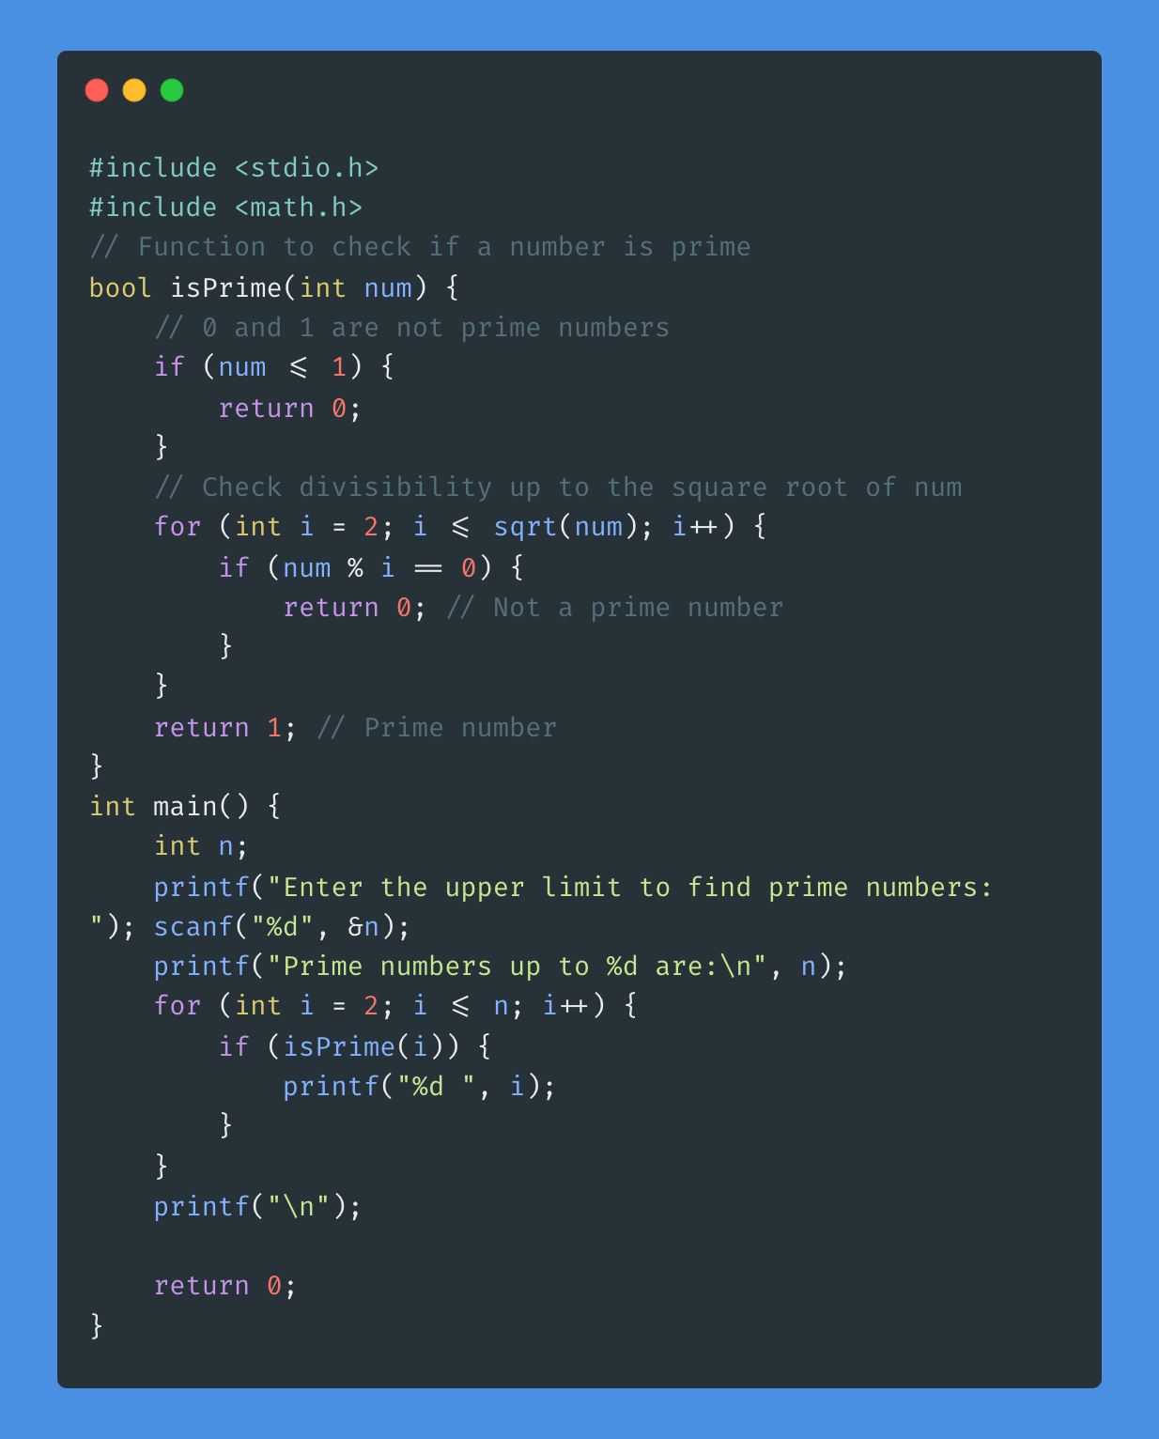
Let’s find prime numbers

Slide 21
Sieve of Eratosthenes

Slide 22
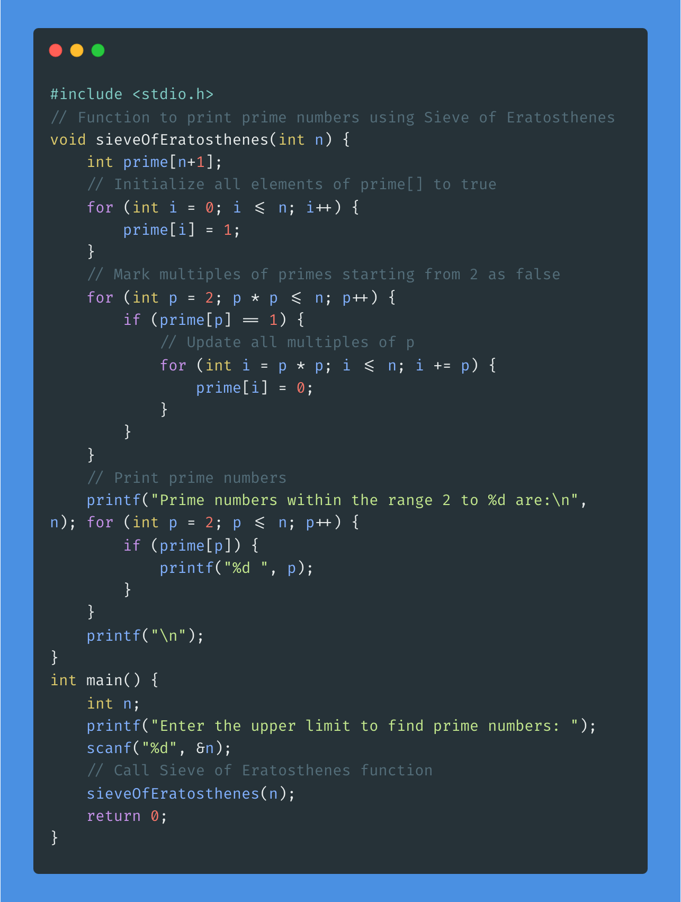
Code

Slide 23
Why is Eratosthenes better?
Efficiency: The Sieve of Eratosthenes is significantly more efficient than the basic method of checking divisibility, especially for large ranges of numbers. Its time complexity is O(n log log n), where n is the upper limit of the range. In contrast, the basic method has a time complexity of O(n*sqrt(n)), which becomes slower as the range increases.
Optimality: The Sieve of Eratosthenes is an optimal algorithm for finding prime numbers within a given range. It efficiently eliminates multiples of prime numbers, ensuring that each composite number is only marked once. This results in an optimal number of iterations required to sieve out composite numbers.
Space Complexity: While the Sieve of Eratosthenes requires additional memory to store the sieve array, the space complexity is still considered reasonable. It only requires O(n) additional space, where n is the upper limit of the range. In contrast, the basic method of checking divisibility does not require additional space beyond the input numbers.
Ease of Implementation: The Sieve of Eratosthenes is relatively easy to implement and understand. It follows a simple, step-by-step procedure of marking multiples of primes, making it accessible even to beginner programmers. In contrast, implementing the basic method of checking divisibility for large ranges can be more complex and error-prone.
Versatility: The Sieve of Eratosthenes can be adapted and extended for various related problems, such as finding prime factors, prime factorization, and checking primality efficiently for multiple numbers within a given range.

Slide 24
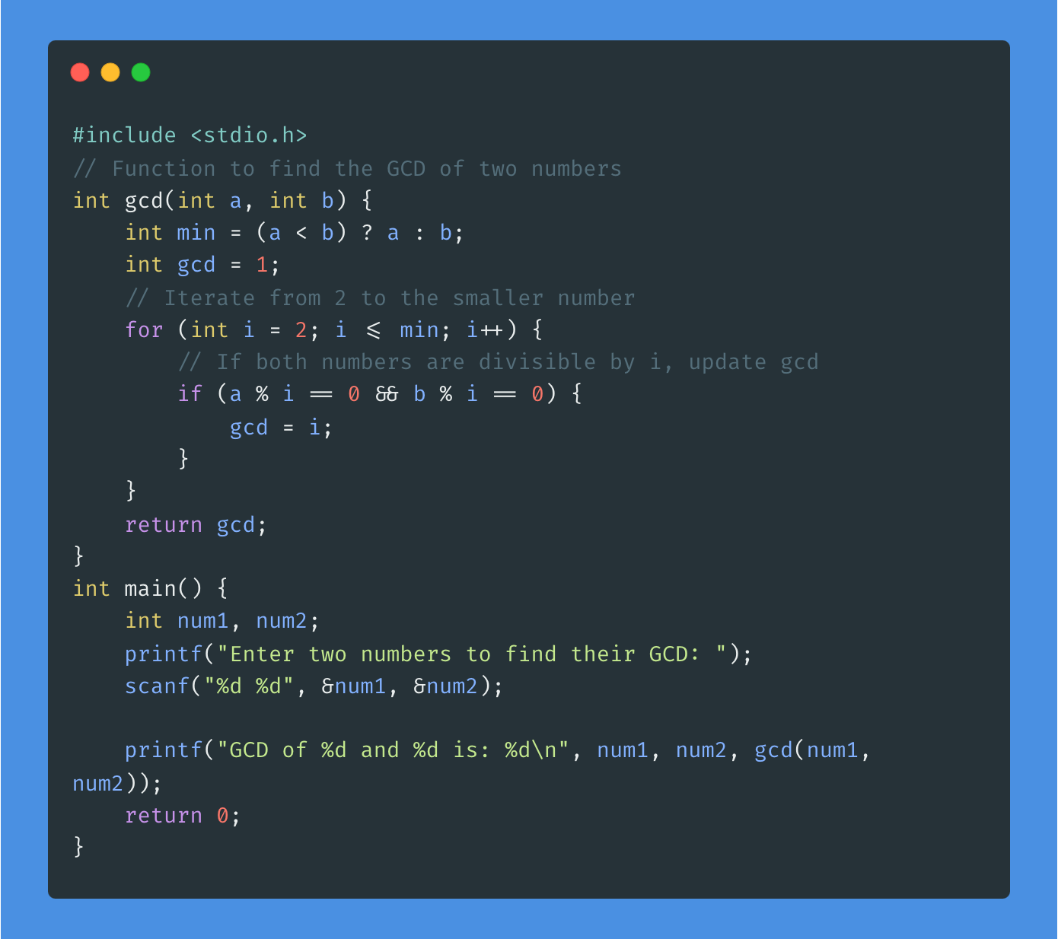
Let’s find gcd

Slide 25
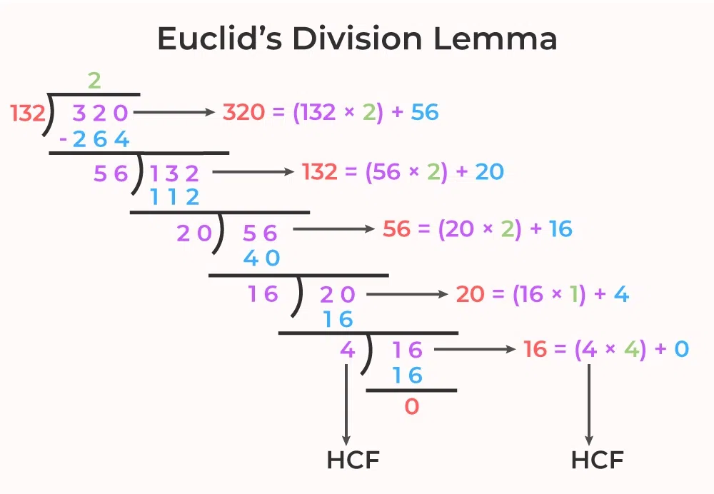
Euclid’s Algorithm

Slide 26
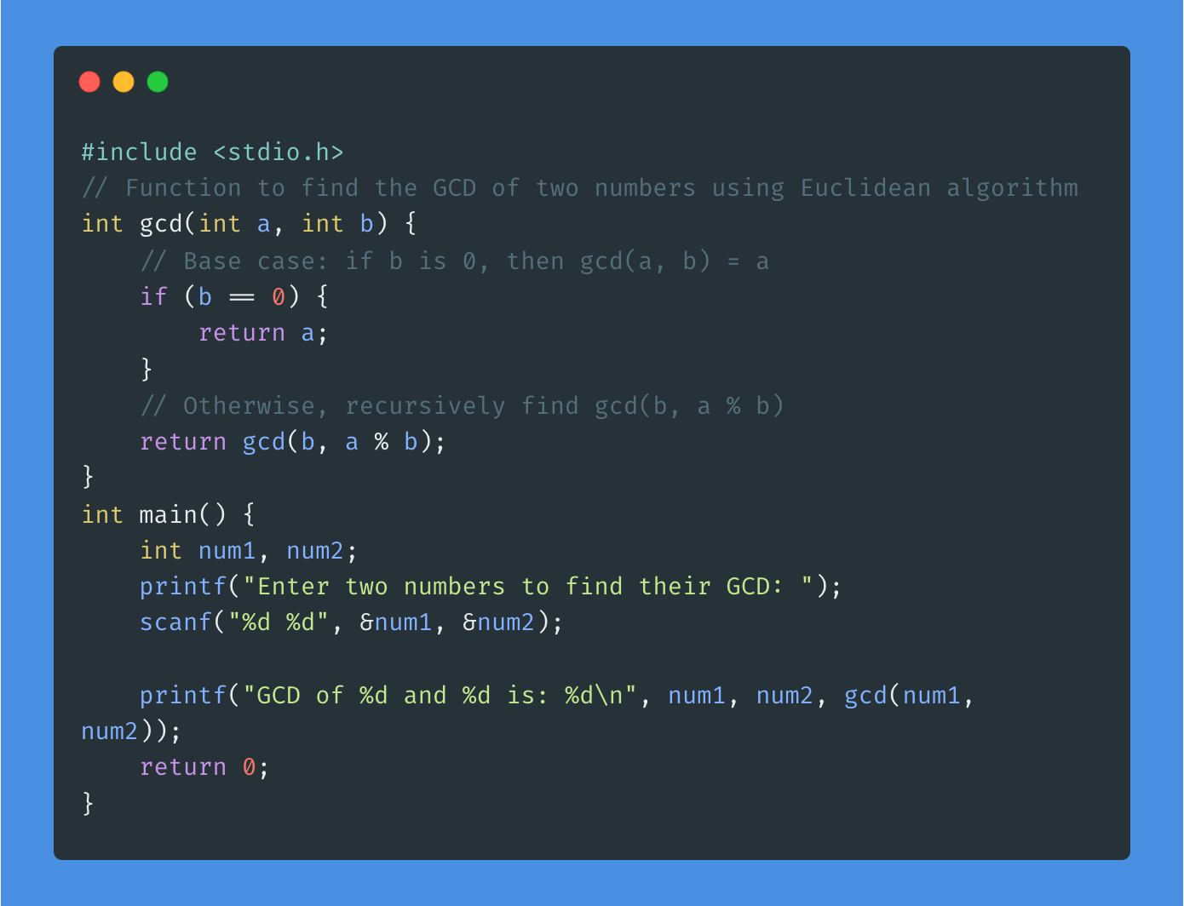
Code

Slide 27
Why is Euclid better?
Efficiency: The Euclidean algorithm is more efficient than the basic iteration approach, especially for large numbers. Its time complexity is O(log(min(a, b))), where a and b are the two input numbers. This makes it significantly faster than the basic iteration approach, which has a time complexity of O(min(a, b)).
Optimality: The Euclidean algorithm is optimal in terms of the number of steps required to find the GCD. It achieves this optimality by repeatedly reducing the problem to a smaller instance until a base case is reached. This contrasts with the basic iteration approach, which checks divisibility for all numbers up to the smaller of the two input numbers.
Simplicity: The Euclidean algorithm is conceptually simpler and more elegant than the basic iteration approach. It leverages the fundamental properties of divisibility and remains straightforward to understand even as the input numbers increase in magnitude.
Versatility: The Euclidean algorithm extends naturally to other mathematical problems, such as finding the least common multiple (LCM) or solving linear Diophantine equations. Its recursive nature lends itself well to solving a variety of related problems efficiently.

Slide 28
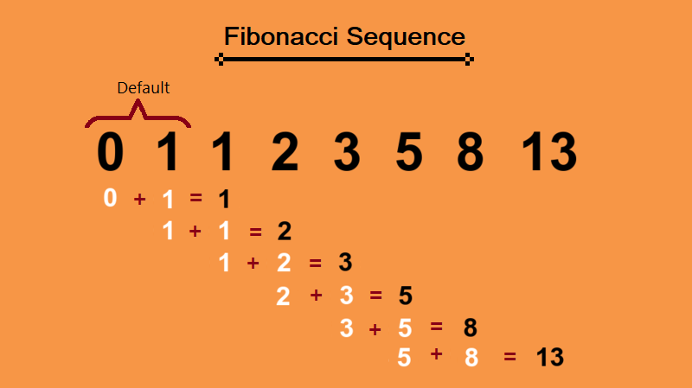
Fibonacci Number

Slide 29
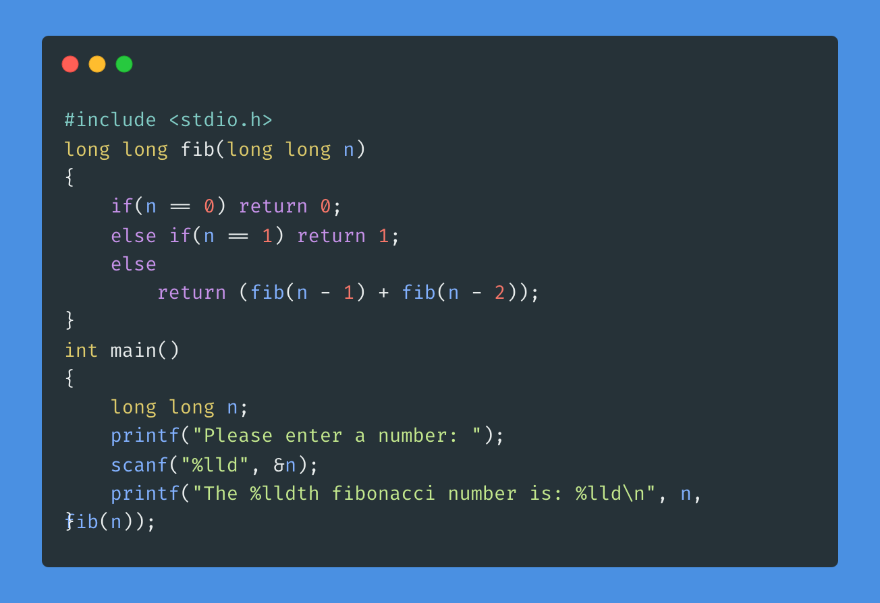
Fibonacci Number Code

Slide 30
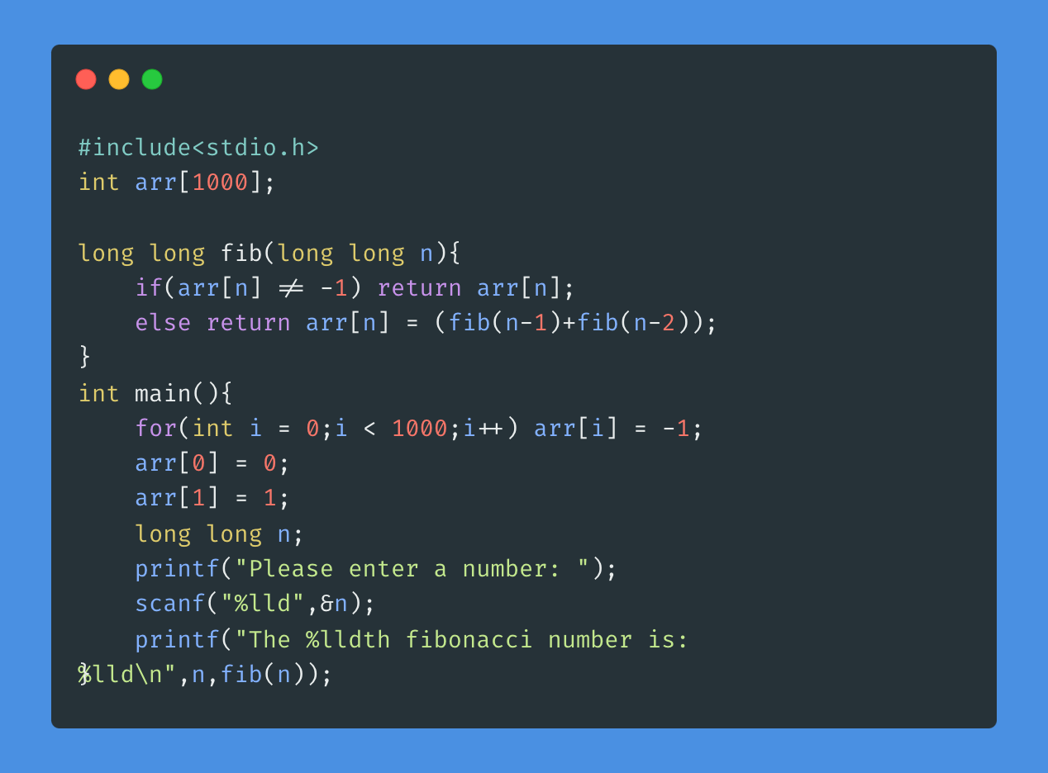
Code with memoization

Slide 31
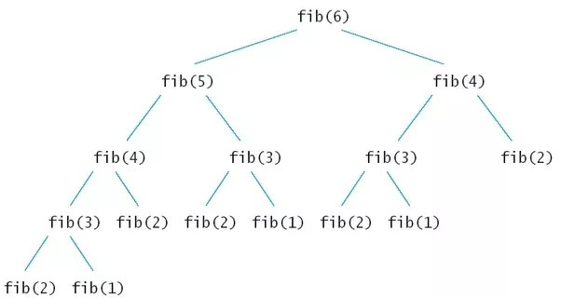
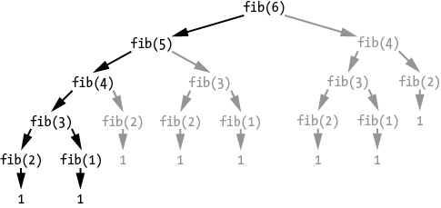
Recursive Tree without memoization

Slide 32
R.T. with memoization

Slide 33
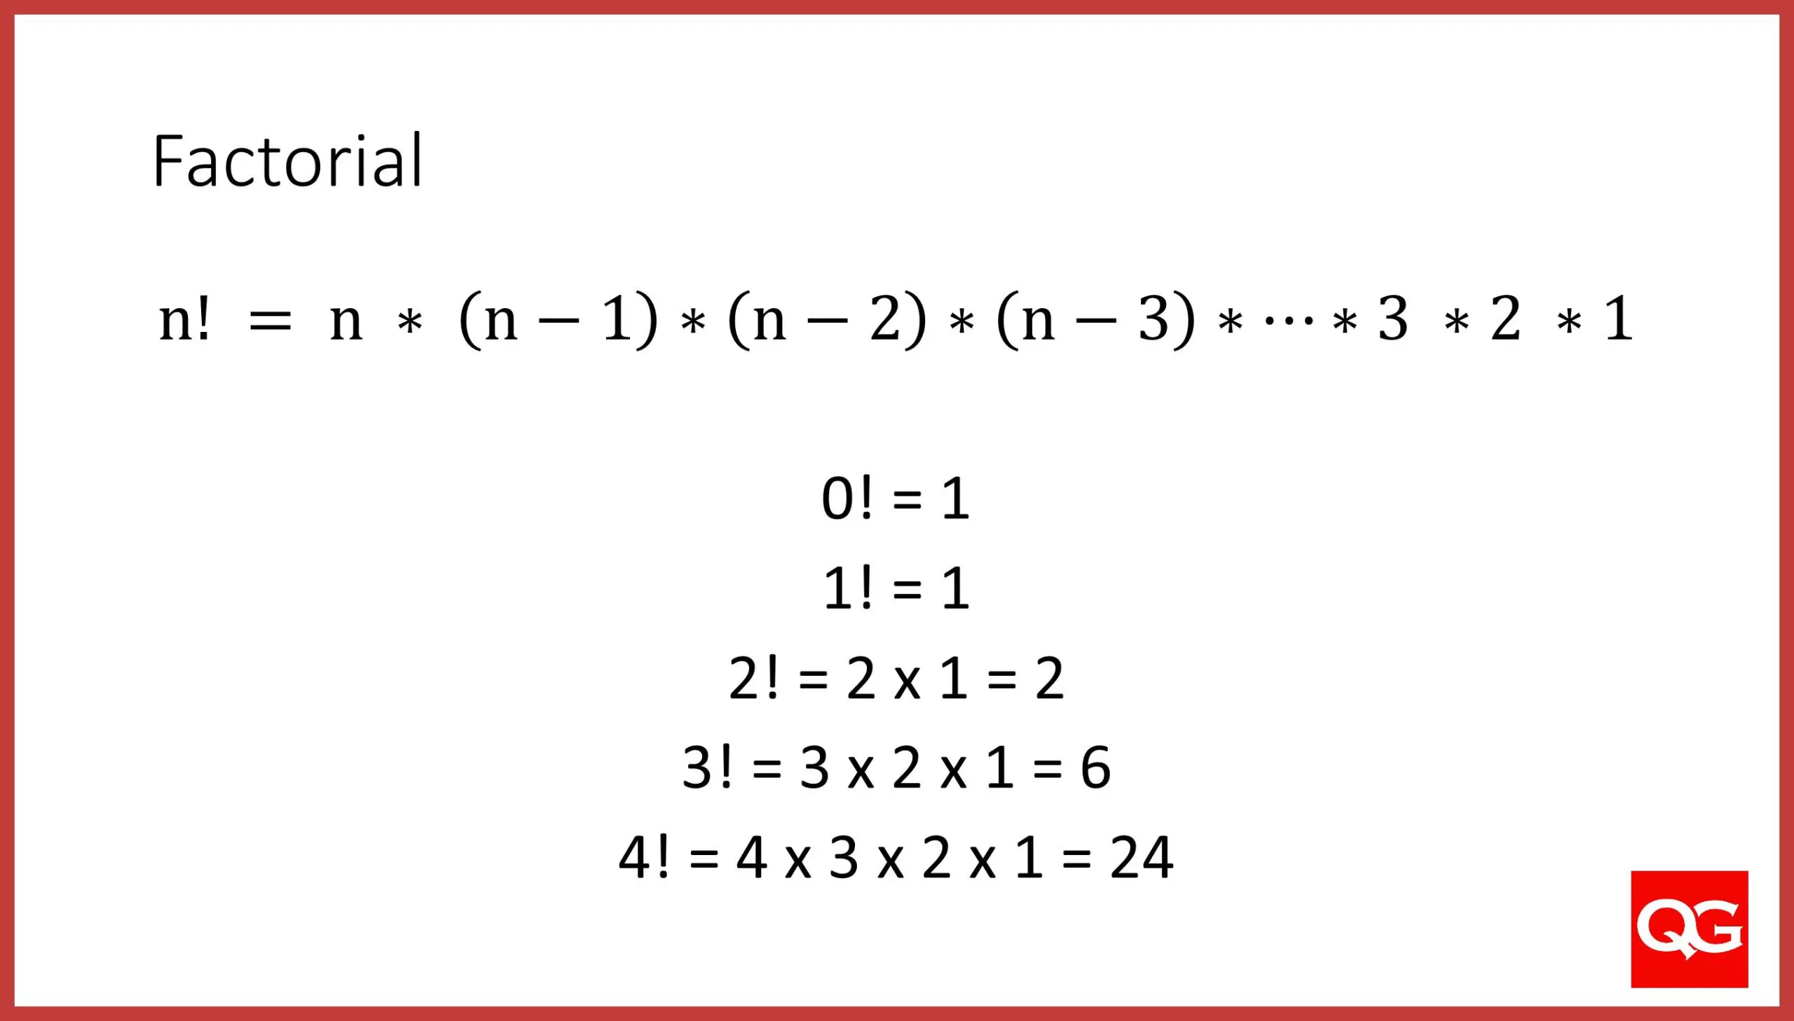
Factorial

Slide 34
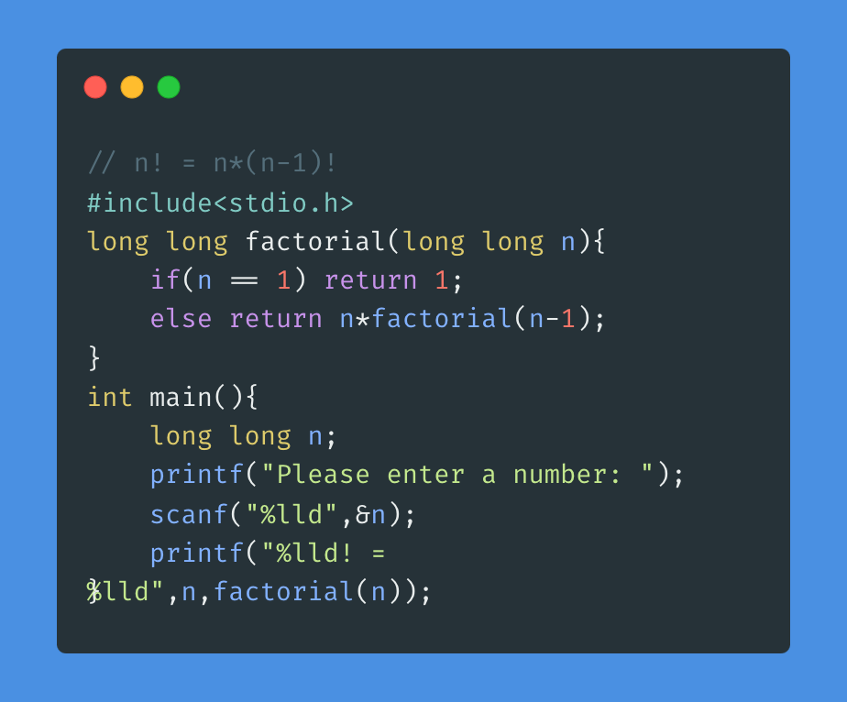
Factorial Recursive Code

